Slide 1

Introduction to Engineering
Activity: Write It Do It

Slide 2
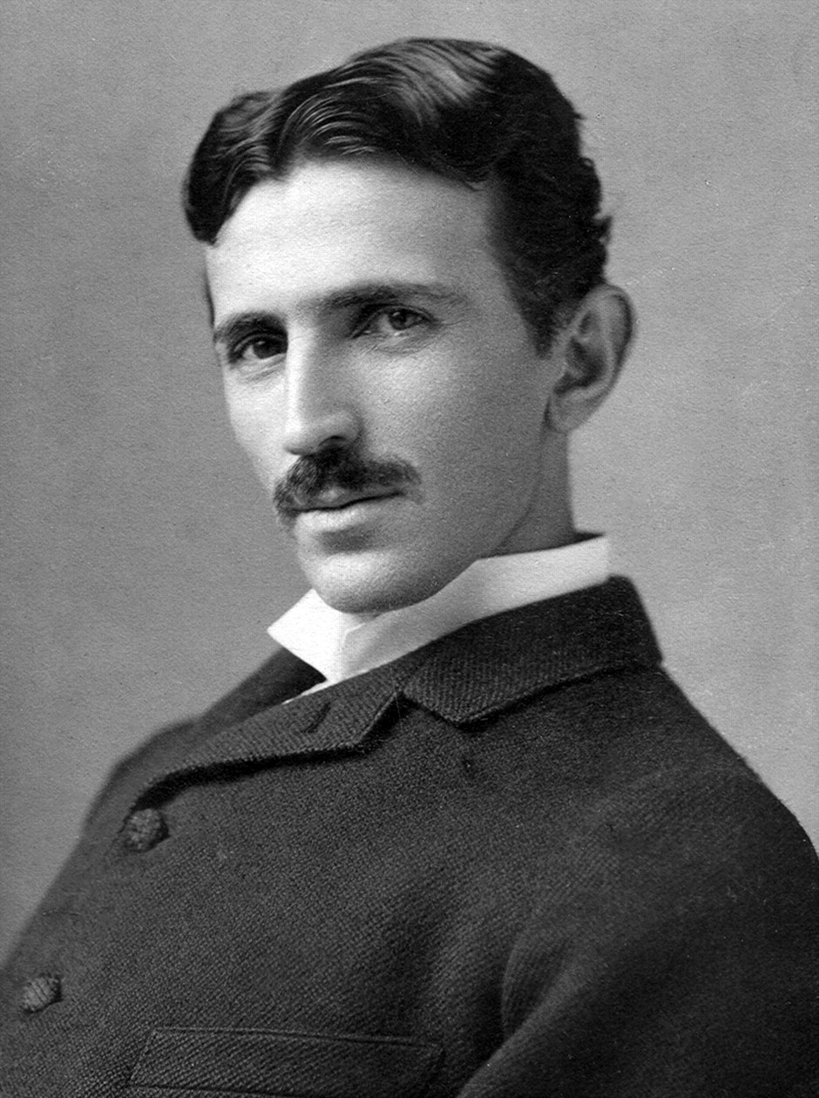

What is Engineering?
Engineering type of Science that involves building or improving machinery or structures
The goal of Engineers are to solve existing problems in machinery or structures and to generally make the world a better place
For example, this can include: designing safer planes, building technology such as phones and computers, and designing skyscrapers
Generally, Engineers solve problems either one of two ways
Invention - Creating an entirely new concept or solution that tackles a problem
Innovation – Building off a previous idea to make it better
Famous 19th Century Engineer
Nikola Tesla
Aerospace Engineer turned Youtuber
Mark Rober

Slide 3
Famous 19th Century Engineer
Nikola Tesla
Engineering Fields
Activity: Write It, Do It!
Get into groups of two, and designate a writer and a builder
The Writers may come up to the front of the room and look at a fully assembled Lego structure
Writers will have 15 minutes at most to write down a precise building instructions to their partner
You can ONLY use words, no diagrams, drawings, photos, etc.
The builder is not allowed to see the structure
The builder will then have at most 20 minutes to reconstruct the structure with the Lego Bricks provided
The builder must only use the instructions provided
There are too many different fields of engineering teach all of them. So, we have picked out a few fields to introduce in the next 4 weeks.
Civil Engineering – Involved in the safe construction and maintenance of infrastructure
Mechanical Engineering – Design, test, and fix machinery such as engines and robots.
Aerospace Engineering – Involved in the designing and testing of aircraft and spacecraft.
Chemical Engineering – Combines chemistry and engineering together to solve problems related to food, drugs, and fuel.
Aerospace Engineer turned Youtuber
Mark Rober

Slide 4
Aerospace Engineer turned Youtuber
Mark Rober
Activity: Write It, Do It!
Lesson: Communication
Get into groups of two, and designate a writer and a builder
The Writers may come up to the front of the room and look at a fully assembled Lego structure
Writers will have 15 minutes at most to write down a precise building instructions to their partner
You can ONLY use words, no diagrams, drawings, photos, etc.
The builder is not allowed to see the structure
The builder will then have at most 20 minutes to reconstruct the structure with the Lego Bricks provided
The builder must only use the instructions provided
Following instructions was harder than it looked!
Use quantitative descriptors instead of qualitative ones
E.g. “place the three long yellow brick five studs to the left of the 5 long green plate” rather than “place the yellow Lego left of the green Lego”
Efficient Communication and Collaboration is very important to engineers.
When engineers share their work and propose new ideas, they use quantitative descriptions
This way everyone can understand

Slide 5
Aerospace Engineer turned Youtuber
Mark Rober
Activity: Write It, Do It!
Lesson: Communication
Get into groups of two, and designate a writer and a builder
The Writers may come up to the front of the room and look at a fully assembled Lego structure
Writers will have 15 minutes at most to write down a precise building instructions to their partner
You can ONLY use words, no diagrams, drawings, photos, etc.
The builder is not allowed to see the structure
The builder will then have at most 20 minutes to reconstruct the structure with the Lego Bricks provided
The builder must only use the instructions provided
Following instructions was harder than it looked!
Use quantitative descriptors instead of qualitative ones
E.g. “place the three long yellow brick five studs to the left of the 5 long green plate” rather than “place the yellow Lego left of the green Lego”
Efficient Communication and Collaboration is very important to engineers.
When engineers share their work and propose new ideas, they use quantitative descriptions
This way everyone can understand

